Slide 1
USA Housing Price Prediction
By: Moshe Gamerberg

Slide 2
USA Housing Price Dataset background
This dataset is based on the prices of the apartments and houses in the United States. Each are listed with its “Average Area Income”, “Average Area House Age”, “Average Area Number of Rooms”, “Average Area Number of Bedrooms”, “Area Population”, “Price”, and “Address”

Slide 3
My Interest in USA Housing Price
I chose USA Housing Price Prediction because I believe it is important to figure out the housing price whenever you are finding a job in the USA and figuring out which place you can afford to go to stay while getting a job. In the case we are given offers to have jobs in different cities of the US, then we can use this dataset to compare how good those offers are depending how expensive the housing prices are in those places, and to see which of those offers is better to take.

Slide 4
Variables within the Dataset
'Avg. Area Income': Average Income of residents of the city house is located in.
'Avg. Area House Age': Average Age of Houses in same city
'Avg. Area Number of Rooms': Average Number of Rooms for Houses in same city
'Avg. Area Number of Bedrooms': Average Number of Bedrooms for Houses in same city
'Area Population': Population of city house is located in.
'Price': Price that the house sold at
'Address': Address for the house

Slide 5

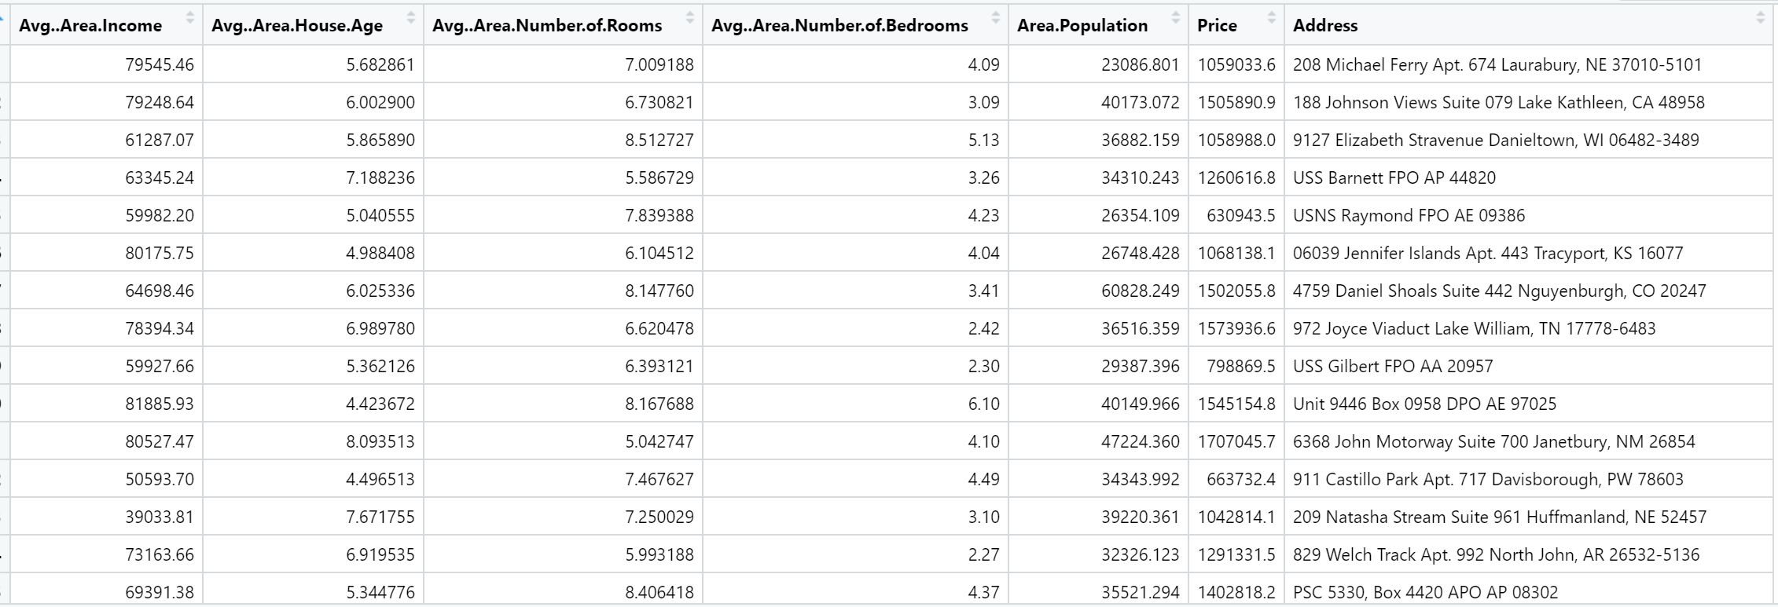
Piece of the Table

Slide 6
Using RSTUDIO
I used the ggplot coding in the Rstudio to compare each of the variables within the dataset with the price.
The variables were the x values while the price was the y value
There are 5000 observations and 7 variables

Slide 7
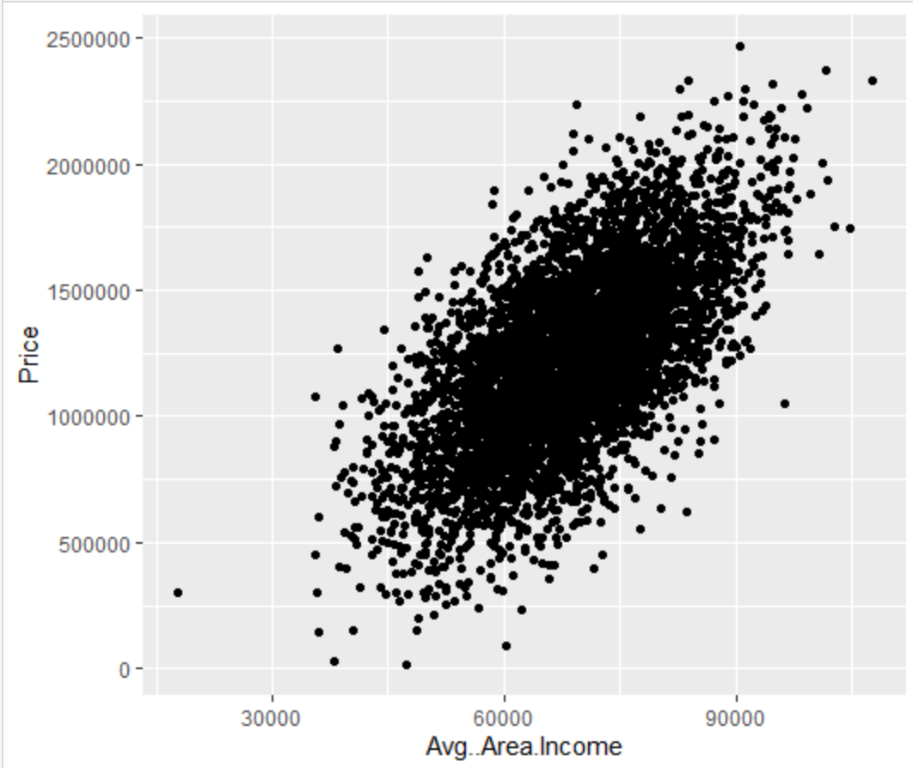
Average Area Income
It seems in the graph that the higher the average area income, the higher the price. People with a higher income can buy a more expensive house.
The correlation value of this graph is 0.6397338

Slide 8
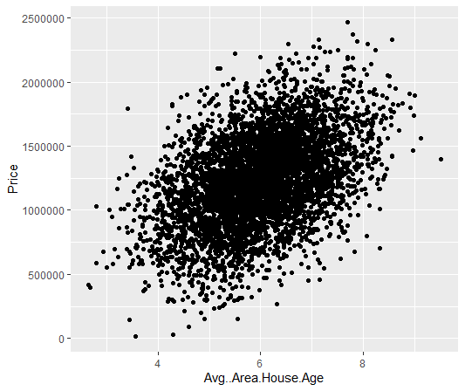
Average Area House Age
It seems in the graph that the higher the average area house age, the higher the price. People with a higher house age can buy a more expensive house.
The correlation value of this graph is 0.4525425

Slide 9
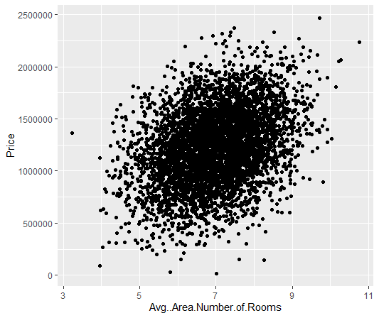
Average Area Number of Rooms
It seems in the graph that the higher the average area income, the higher the price. A higher number of rooms can lead to a more expensive house.
The correlation value of this graph is 0.3356645

Slide 10
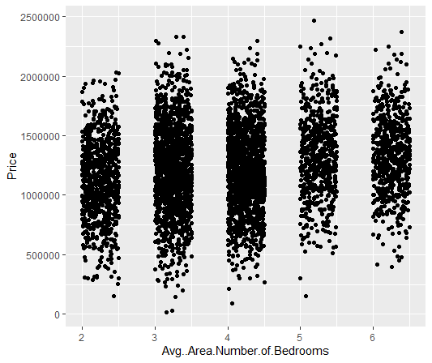
Average Area Number of Bedrooms
It seems that the number of bedrooms doesn’t affect the price because there’s barely an increase or decrease in the price compared to the number of bedrooms.
The correlation value of this graph is 0.171071

Slide 11
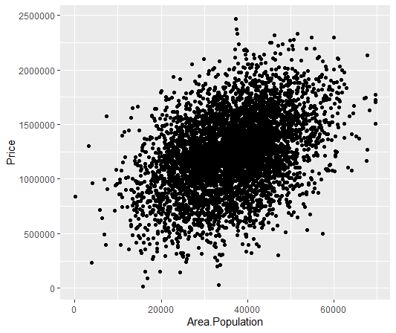
Area Population
It seems in the graph that the higher the area population, the higher the price. The population can affect the housing price by that much.
The correlation value of this graph is 0.4085559

Slide 12
Address
The centrality of the location in the US has proven to affect the US Housing Price value. Homes in cities, for example, tend to be placed at a higher price than homes in the suburbs. When comparing these addresses, it has been shown that homes in cities were the most expensive compared to the other types of homes.
https://www.visualcapitalist.com/20-years-of-home-price-changes-in-every-u-s-city/
This website has the comparison of US Housing Price between cities throughout 20 years

Slide 13

Compare all the correlation values
Variable | Correlation
Average Area Income | 0.6397338
Average Number of Rooms | 0.3356645
Average Number of Bedrooms | 0.171071
Average Area Housing Age | 0.4525425
Area Population | 0.4085559
It seems that the strongest indicator of the USA Housing Price Prediction is the Average Area Income due to its correlation being closer to one than the rest of them. This variable must also be the strongest indicator since the average area income affects the price more than the other variables do according to the graphs.
The weakest indicators of the USA Housing Price Prediction is the Average Area Number of Bedrooms and the Average Number of Rooms due to these two having the smallest correlations, and it seems that the number of rooms and bedrooms only have a small affect on the USA Housing Price.

Slide 14
Compare all the correlation values
Variable | Correlation
Average Area Income | 0.6397338
Average Number of Rooms | 0.3356645
Average Number of Bedrooms | 0.171071
Average Area Housing Age | 0.4525425
Area Population | 0.4085559
The Average Area Housing Age has the second highest correlation, so that means that the housing age affects the housing price more than almost all the other variables except for the housing income, probably because the older the houses are, the more expensive the houses seem to be.
The Area Population has the third highest correlation, which means that the population affects the housing price, but not as much as the housing age and area income.

Slide 15
Problems I encountered while trying to make the data visualization for the graphs
I had an extremely difficult time trying to figure out how to compare the address with the price, because there’s no way I could’ve graphed it, so I needed to use only the table itself, which I can’t put in the PowerPoint due to how big the table is. Not only that, but there was also no way for me to find a correlation for the addresses.

Slide 16
conclusion
It seems according to the dataset given in US Housing Price Prediction that when it comes to predicting the housing price in the US, what is most important to check is the area income, the housing age, and the area population, due to how they affect the housing price more than the other categories do. The number of rooms and bedrooms add a small change to the price, with the more rooms, the more expensive, but not as effective as the area income, the housing age, or the area population. Now we have seen what is required for predicting the US housing price, it is easier to compare how good the job offers given are depending how expensive the housing prices are in those places, and to see which of those offers is better to take.

